Slide 1
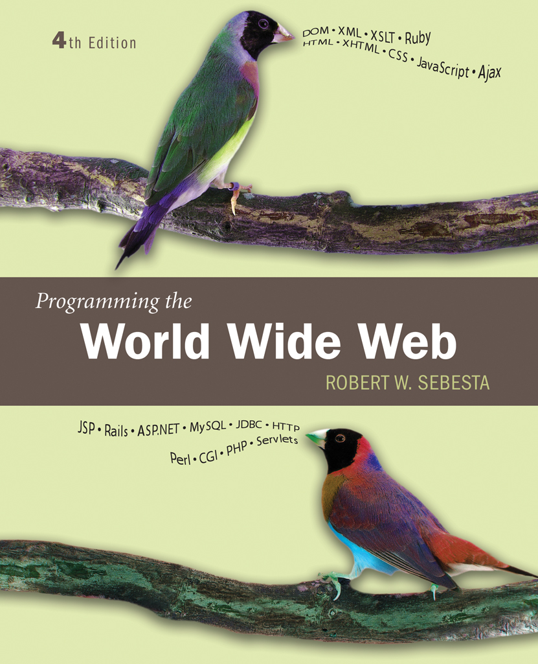
Chapter 14
Introduction to Ruby

Slide 2
14.1 Origins and Uses of Ruby
Developed by Yukihiro Matsumoto about 1996
Purely interpreted
  Somewhat easier learning because of simple structure
Notable characteristics
  Regular expressions based on Perl
  Dynamic classes based on JavaScript

Slide 3
14.2 Scalar Types and Their Operations
Three categories of data
  Scalrs
  Arrays
  Hashes
All values are objects, including numeric values

Slide 4
14.2 Numeric Literals
Numeric data are descendants of class Numeric
  Float and Integer
  Fixnum and Bignum
Integer literals are Fixnum unless too large, then Bignum
Underscores can punctuate integer literals
Float literals may not have a decimal point first or last

Slide 5
14.2 String Literals
Single or double quoted
  Double quoted has escape characters and expression interpolation
    Expression is specified by #{…}
  Single quoted have not escape characters or expression interpolation
q$...$ for a single quoted string
  $ can be other characters
  <{([ as the start delimiter must be matched by >})] at the end
Q$...$ for a double quoted string

Slide 6
14.2 Variables and Assignment Statements
Variable names indicate category of variables
Variables are not formally declared and do not have a fixed type
An identifier begins with a lower case letter or underscore followed by letters and/or digits and/or underscore
Variables are all references to objects
An unassigned variable has value nil
Named constants are named like variables but have names that begin with a capital letter
There are some implicit variables such as $_
Assignment statements in Ruby are the same as in the C/C++/Java family

Slide 7
14.2 Numeric Operators
Standard operators: + - * / %
  Integer/Integer is integer
** for exponentiation
Missing: ++ and –
Math module: cos, sin, log, sqrt, …
The interactive Ruby interpreter irb takes experssions and responds with the values

Slide 8
14.2 String Methods
Catenation is indicated by +
<< appends its right operand to the left
  Similar to an assignment operator
  += is a synonym
capitalize, chop, chomp, upcase, …
  These create new strings
Mutator versions capialize!, chop!, chomp!, upcase! modify the string

Slide 9
14.2 String Character Access
[ index ]
  Single character reference returns the ASCII code of a character
[index]=
[first-char, numer-of-chars] gets a substring
[first-char, numer-of-chars]= replaces a substring
== compares strings for equality based on content
  equal? compares for the same object
  eql? compares for type and value
<=> compares two strings returning -1 if the first is smaller, 0 if they are equal, +1 if the second is smaller
* is used to repeat a string: “x” * 3 is “xxx”

Slide 10
14.3 Screen Output
Operator puts displays a string on standard output
  A new line is added to the output
Operator print displays a string without the new line

Slide 11
14.3 Keyboard Input
Function gets gets a line of input from the console (keyboard)
gets.chomp returns the next lline of input with out the terminating new line
gets.to_i returns the next line of input converted to an integer
gets.to_f returns the next line of input converted to a float
Example quadeval.rb illustrates console input and output
  Run with the command
  ruby quadeval.rb

Slide 12
14.4 Control Expressions
A Boolean expression
Any value but nil is considered true
Comparison operators
  Usual: == != < > <= >=
  Compare for order: <=>
  Compare for type and value: eql?
  Compare for equality of object: equal?
Operator precedence and associativity
Assignments can be used as control expressions
    next = gets
  This is true as long a there is more input
  Becomes false when input is exhausted

Slide 13
14.4 Selection and Loop Statements
If statement
if control-expression
statements
elsif control-expression
statements
else
statements
end
elsif can be repeated any number of times (including 0)

Slide 14
14.4 Unless
Reverses if, no else or elsif
unless control-expression
statements
end

Slide 15
14.4 Case Syntax
case expression
when value then
- statement sequence
when value then
- statement sequence
[else
- statement sequence]
end

Slide 16
14.4 Case Semantics
Value is matched to when’s using ===
  Defined for all built-in classes
  If the when value is a class, the comparison is true if the case value is an object of the class or one of its superclasses
  If the value is a range, the case value matches if it is in that range
  If the when value is a regular expression, the match is based on pattern matching
When’s do not cascade, so no break statements are needed

Slide 17
14.4 Case Expression
Syntax
case
when Boolean expression then expression
...
when Boolean expression then expression
else expression
end
The first true Boolean expression causes the matching expression to be evaluated as the value of the case
  The else expression is used if none of the Booleans are true

Slide 18
14.4 Loops
While loop repeats while control expression is true
Until loop repeats until control expression is true
loop introduces an infinite loop
  A code block is a sequence of statements delimited by braces or by keywords begin and end
  The loop keyword is followed by a code block
  Exit from the loop is by the break statement
  The next statement causes control to go back to the beginning of the code block
Iterator methods are an important repetition construct in Ruby

Slide 19
14.5 Fundamentals of Arrays
Ruby arrays are dynamic in size and can store different types of data in different elements
Creating an array
  Array.new(size)
  Array.new(size, value)
  A literal list such as [2, 4, 6]
Element access through subscript [sub]
Element assignment through [sub]=

Slide 20
14.5 The for-in Statement
Syntax
for variable in list
statements
end
The variable takes on each value in the list
  This is not a reference but a value copy

Slide 21
14.5 Build-In Methods for Arrays and Lists
push inserts at the end of a list
pop removes from the end of a list and returns the value
unshift inserts at the beginning of a list
shift removes from the front of a list and returns the value
Arrays catenated with +
Method reverse returns a reversed copy
Method reverse! reverses the array
include? searches an array
sort sorts an array, returns a new array

Slide 22
14.5 An Example
The process_names.rb example illustrates using arrays

Slide 23
14.6 Hashes
Hashes are like arrays but use string indexes
  Indexes are keys and elements are values
Hash elements are not ordered
Creating a Hash
  Hash.new
  Literal hash as in {“a”=>1, “b”=>2}
Element access using string ‘subscripts’
Elements are added by using assignment
Elements are removed using delete method
The clear method removes all elements
has_key? checks if a string is a key in a hash
Methods keys and values return arrays of the respective components

Slide 24
14.7 Methods
Methods can be defined outside classe
When a method is called without an object reference, the default is self

Slide 25
14.7 Fundamentals of Methods
Method syntax
def name [( formal-parameters )]
statements
end
  Parentheses can be omitted if there are no formal parameters
Return statement ends execution of the method
  With a value, it returns the value as the value of the method
  If no return ends a method, the last expression is the value of the method

Slide 26
14.7 Local Variables
Variables used in a method are local to the method
Global variables with the same name are hidden
Local variable names must begin with a lowercase letter or an underscore
The lifetime of a local variable from its creation to the end of the execution of the method

Slide 27
14.7 Parameters
Parameters are passed by value unless arrays and hashes
  Arrays and hashes are passed by reference
The number of actual parameters must match the number of formal parameters
  If the last formal parameter is preceded by an asterisk, it receives all actual parameters not matched to earlier formal parameters
Formal parameters can be assigned default values, so the corresponding actual parameter may be omitted
If a hash literal is the last actual parameter, the curly braces are not required
  In this case symbols are conventionally used as the keys
  A symbol is an unquoted string preceded by a colon
Example method median computes the median of an array parameter

Slide 28
14.8 Basics of Classes
Syntax
class class-name
…
end
Class names begin with an uppercase letter
Instance variables have instances for each object
  Names begin with @
Constructor is named initialize
Example class Stack2_class implements a stack class
Members can by dynamically added and removed from a class
  Method remove_method removes a method

Slide 29
14.8 Access Control
Three levels
  Public: every method has access
  Private: only methods of the object have access
    Private methods may not be invoked with an object reference, so must default to self
    Different from C++ and Java
  Protected: only methods of the class or subclasses have access
Instance data is private and that cannot be changed
Access control methods change access level
  Invoked without parameters change the default for following methods
  Invoked with parameters, these are symbols naming methods that have access changed

Slide 30
14.8 Attributes
Method addr_reader takes symbol arguments and defines get methods named after the symbols
    addr_reader :val
  Defines a method named val that returns the value of @val
Method addr_writer takes symbol arguments and defines an assignment method
    addr_writer :val
  Defines a method named val= that allows assignment to the attribute as in
    obj.val = 17;

Slide 31
14.8 Inheritance
Syntax
class My_Subclass < Base_class
Access level of a method can be changed in a subclass
  A method can be made private and, thus, inaccessible through that subclass
Modules define namespaces that are often used to hold sets of methods
Modules may be mixed in to classes, providing methods to the class by a non-inheritance route

Slide 32
14.9 Code Blocks and Iterators
A code block is a sequence of statements delimited by braces or by do/end
  A code block can have parameters, listed at the beginning of the block, surrounded by vertical bars: |a, b|
A code block may be passed to a method call, following the actual parameters of the call
In the method body, a call to yield will executed the block
  Actual parameters of the call are matched with the block parameters
An iterator applies a block to the values in a list

Slide 33
14.9 Built-in Iterators
each is a method of arrays and takes a block that has one parameter
  The block is executed with the block parameter taking each element of the list in turn
The upto method applies to integers and takes an integer parameter and a block with one parameter
  The block is executed for each value in the range from the target integer to the actual parameter, inclusive
The collect method creates an array from the results of applying a block to each element in an array

Slide 34
14.10 Pattern Matching
Pattern matching in Ruby is based on pattern matching in Perl

Slide 35
14.10 Basics of Pattern Matching
Patterns are delimited by slashes
=~ is the pattern matching operator
The split method is used to split a string with separators given by a regular expression
The example word_table.rb uses the split method to divide up input lines into words
  A hash is used to count word frequencies

Slide 36
14.10 Remembering Matches
Parts of a regular expression pattern can be enclosed in parentheses
If there is a match, the variables $1, $2 … hold the strings matched by the parenthesized parts
If there is a match, $`, $& and $’ hold the part of the target before the match, the part matched and the part after the match

Slide 37
14.10 Substitutions
Method sub substitutes its second parameter for the first match found of the first parameter
Method gsub is similar but substitutes for all matches
Both methods create new strings
sub! and gsub! change the target string
The i modifier on a pattern causes the match to ignore letter case

